Slide 1

A Internship Reveiw Presentation on
“Sudoku Solver”
Submitted to Savitribai Phule Pune University
for the partial fulfillment of Under Graduate Degree in
Computer Engineering
Presented By
Mr. Adhav Atish G. | PRN : 72331792F
Mr. Binnar Vaibhav R. | PRN : 72257455L
Mr. Kolhe Suraj S. | PRN : 72257564F
Guided By
Company Superviser Name Prof. S.G. Bodke
Department of Computer Engineering
PVG’s College of Engineering & S. S. Dhamankar Institute of Management, Nashik Academic Year 2024 - 25

Slide 2
Outline
Introduction.
  Introduction Internship Related Work
  Objective of training
  Problem Statement of Project
Project Related Work
Hardware and Software Requirement
Algorithm and Flowchart
Project Implementation detail.
Conclusion
References.
PVG’s COE&SSDIOM Nashik | Department of Computer Engineering

Slide 3
1. Introduction to internship
Introduction.
Introduction Internship Related Work
  Working on web-based application development, improving skills in front-end technologies and problem-solving algorithms.
2. Objective of Training
Gaining hands-on experience in web development.
Learning and implementing algorithmic problem-solving techniques.
Developing an engaging and interactive user interface.
3. Problem Statement of Project
Designing and developing a web-based Sudoku game that allows users to play interactively, with an integrated solver for assistance and validation.
PVG’s COE&SSDIOM Nashik | Department of Computer Engineering

Slide 4
2. Introduction to Project Related Work
Introduction
Sudoku Solver is a project that tackles the popular 9×9 logic puzzle—where each row, column, and 3×3 block must contain the digits 1 through 9, by using multiple algorithms. It compares methods like backtracking, constraint propagation, and Dancing Links to efficiently solve puzzles, even those with few initial clues. In addition, it uses image processing to automatically extract puzzles from images, making it a versatile and practical tool.
Objectives
Created an interactive 9×9 grid where users can play Sudoku game.
Embed a robust solving algorithm (e.g., backtracking or constraint programming) that can solve puzzles in real time.
Designed a polished and intuitive user interface with features like difficulty selection, timers, and score tracking.
PVG’s COE&SSDIOM Nashik | Department of Computer Engineering

Slide 5
2. Introduction to Project Related Work
Project Category
Algorithm Development: Designing and implementing algorithms, such as backtracking or constraint propagation, to efficiently solve Sudoku puzzles. ​
Application Development: Creating a user-facing application that allows users to input Sudoku puzzles and receive solutions, possibly with interactive features. ​
Game Development: Developing a puzzle-solving game that challenges users and provides an engaging experience. ​
Educational Software: Offering insights into algorithmic problem-solving and logical deduction, serving as a learning tool for users interested in these areas.
Tech stack used :
HTML, CSS and JavaScript - A web-based interactive Sudoku game
PVG’s COE&SSDIOM Nashik | Department of Computer Engineering

Slide 6
3. Hardware and Software Requirement
Hardware Requirements
Processor: 1 GHz CPU (modern devices recommended for smooth performance).
Memory: 1 GB RAM (2 GB or more is preferred).
Display Resolution: At least 1024×768 pixels
Input Devices: Desktop: Keyboard and mouse. Mobile: Touchscreen.
Software Requirements
Operating System: Compatible with Windows, macOS, Linux, iOS, and Android.
Development Tools : Visual Studio Code or any editor
Libraries/Frameworks : Core technologies: HTML, CSS, and JavaScript
PVG’s COE&SSDIOM Nashik | Department of Computer Engineering

Slide 7
4. Algorithm and Flowchart
Algorithm
1. Function isSafe(sudoku, row, col, digit):
Check if digit exists in the same column → Return False if found.
Check if digit exists in the same row → Return False if found.
Check if digit exists in the 3x3 sub-grid → Return False if found.
If all checks pass, return True.
2. Function sudokuSolver(sudoku, row, col):
Base Case: If row == 9, solution is found → Return True.
Calculate the next row and column to move to the next cell.
If the current cell is already filled, recursively move to the next cell.
Try placing numbers 1 to 9:
  If isSafe(), place the digit and call sudokuSolver() for the next cell.
  If recursion fails, backtrack (set sudoku[row][col] = 0).
If no valid digit works, return False.
3. Function printSudoku(sudoku):
Print the 9x9 grid in a structured format.
4. Main Function:​
Initialize the Sudoku puzzle (9x9 grid).
Call sudokuSolver(sudoku, 0, 0).​
If solution exists → Print "Solution exists" and
display Sudoku.
Else → Print "Solution does not exist".
PVG’s COE&SSDIOM Nashik | Department of Computer Engineering

Slide 8
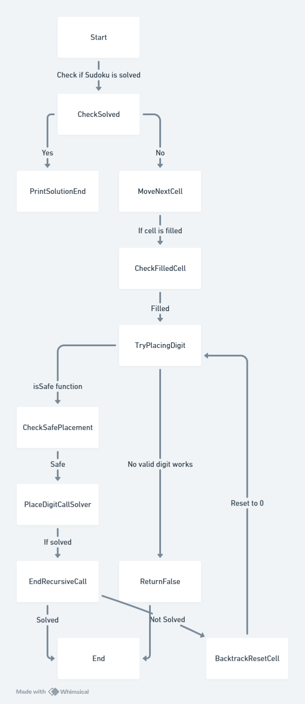
4 Flowchart
PVG’s COE&SSDIOM Nashik | Department of Computer Engineering

Slide 9
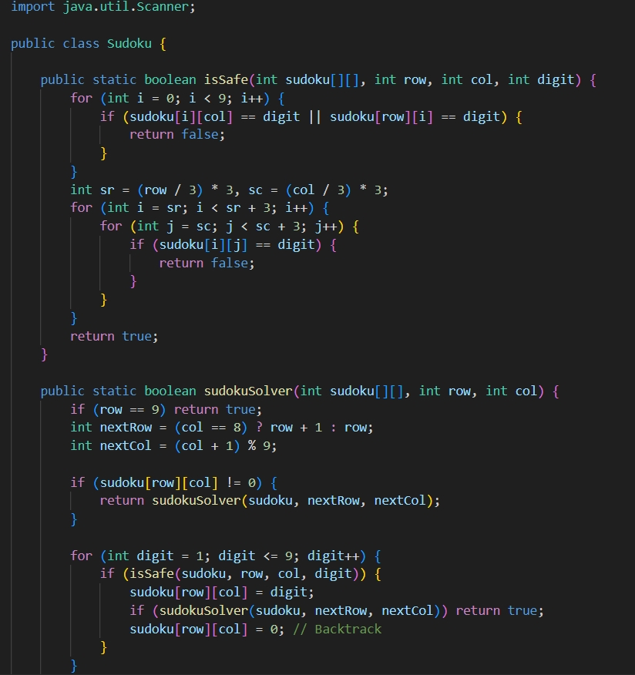
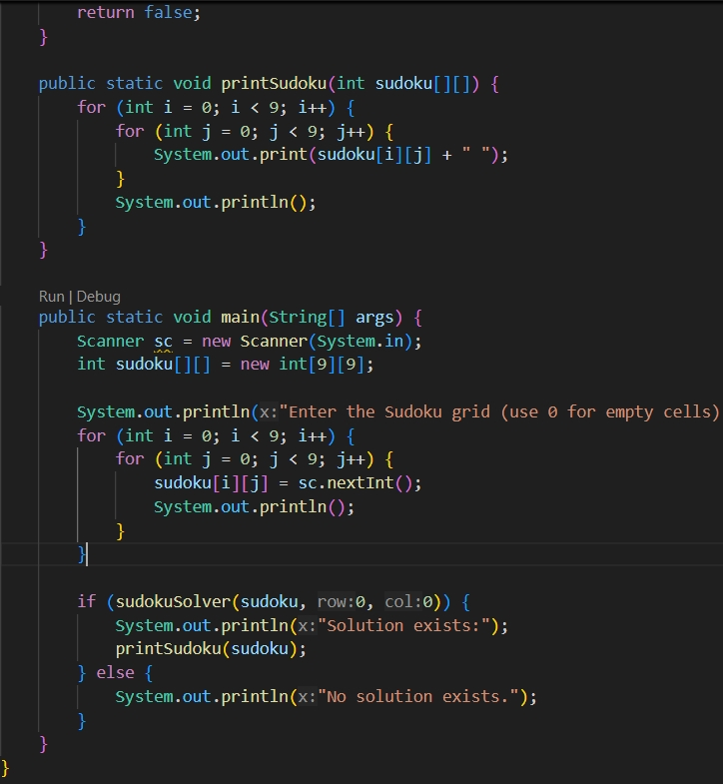
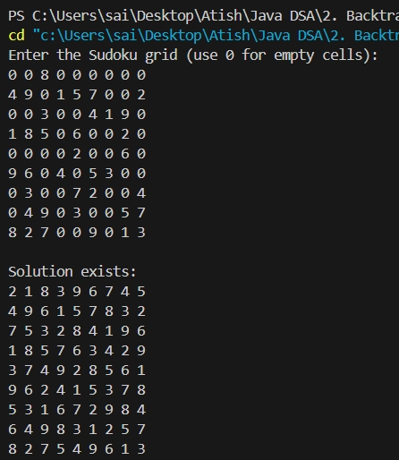
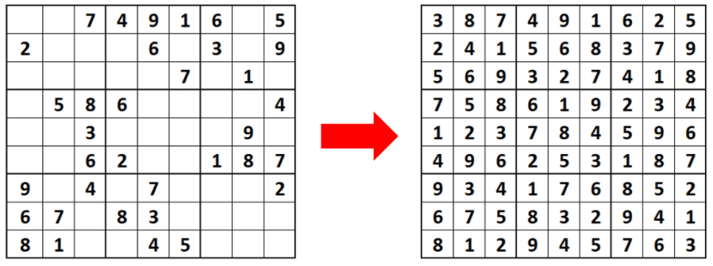
5. Project Implementation Detail
PVG’s COE&SSDIOM Nashik | Department of Computer Engineering

Slide 10
6. Domain Knowledge and Skill you Learn
Web Development:
Proficiency in HTML, CSS, and JavaScript for creating dynamic, responsive interfaces.
Algorithmic Thinking:
Implementing and optimizing puzzle-solving algorithms. (Backtracking)
UI/UX Design: Designing intuitive and engaging user interfaces.
Version Control: Managing code efficiently with tools like Git.
PVG’s COE&SSDIOM Nashik | Department of Computer Engineering

Slide 11
4. Conclusion
Created an interactive Sudoku game using HTML, CSS, and JavaScript.
Implemented a solving algorithm (backtracking) for efficient gameplay.
Improved skills in web development and problem-solving.
Gained experience in UI/UX design and interactive application development.
PVG’s COE&SSDIOM Nashik | Department of Computer Engineering

Slide 12
5. References
S. Jana, N. Dutta, A. K. Maji, and R. K. Pal, ‘‘A novel time stamp-based audio encryption scheme using sudoku puzzle,’’ in Proc. Int. Conf. Fron
S. Jana, M. Mallik, A. K. Maji, and R. K. Pal, ‘‘A novel search tree-based 3D Sudoku solver,’’ in Proc. Int. Conf. Comput. Commun. Syst. Berlin, Germany: Springer, 2021, pp. 709–718.
N. Ikeo, H. Fukuda, A. Matsugaki, T. Inoue, A. Serizawa, T. Matsuzaka, T. Ishimoto, R. Ozasa, O. Gokcekaya, and T. Nakano, ‘‘3D puzzle in cube pattern for anisotropic/isotropic mechanical control of structure fab ricated by metal additive manufacturing,’’ Crystals, vol. 11, no. 8, p. 959, Aug. 2021.
[N. Capece, U. Erra, M. Gruosso, and M. Anastasio, ‘‘Archaeo puzzle: An educational game using natural user interface for historical artifacts,’’ in Proc. Eurograph. Workshop Graph. Cultural Heritage, M. Spagnuolo and F. J. Melero, Eds. Lecce, Italy: The Eurographics Association, 2020, pp. 99–102.
B.-B.Xia,A.-H.Wang,C.-C.Chang,andL.Liu,‘‘Animagesteganography scheme using 3D-sudoku,’’ J. Inf. Hiding Multimedia Signal Process., vol. 7, no. 4, pp. 836–845, Jul. 2016.
A. K. Maji, S. Jana, and R. K. Pal, ‘‘A comprehensive sudoku instance generator,’’ in Advanced Computing and Systems for Security. Berlin, Germany: Springer, 2016, pp. 215–233.
PVG’s COE&SSDIOM Nashik | Department of Computer Engineering

